Slide 1
Characterizing the Complexity of Fibrillation from Models and Experiments with Lyapunov Exponents
Will AN
Mikael Toye and Prof. Flavio H. Fenton

Slide 2
Quantify fibrillation of heart
Heart fibrillation, some come and go, some may be persistent, shows up as irregular pattern in heartbeat or more specifically, in electrical signal.
Some of them are shown to be more periodic, but some might be lethally chaotic.
Now, to distinguish between the periodic, less chaotic and strongly chaotic patterns, we use Lyapunov exponent.
less chaotic electrical signal
chaotic electrical signal

Slide 3
Quantify fibrillation of heart – Lyapunov exponent
Lyapunov exponent of a dynamical system is to characterizes the rate of separation of infinitesimally close trajectories.
Formula for LE
λ > 0: chaotic system
δ(t)>>δ(0) (difference has exp growth)
λ = 0: periodic
δ(t)=δ(0) (difference has no growth)
λ < 0: stable (convergent to fix point)
Usually, we use the maximal Lyapunov exponent (MLE)
Which is the maximum possible LE you could get during iterations.
This means chaos

Slide 4
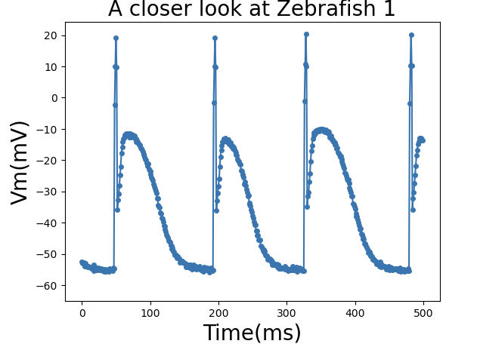
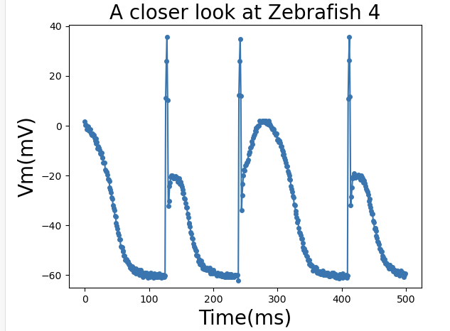
Quantify fibrillation of heart - Challenge
If we look closer at the electrical signal
Most of the data points for electrical signal locate on the latter part of downstroke state and resting state
So that part dominates in chaos quantify, which has almost no difference between chaotic and non-chaotic pattern

Slide 5
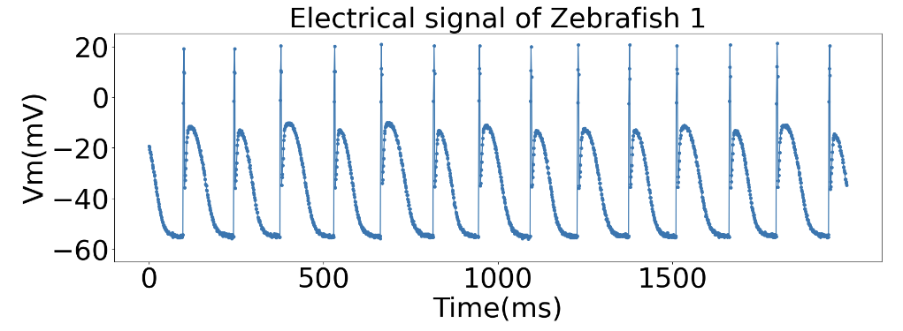
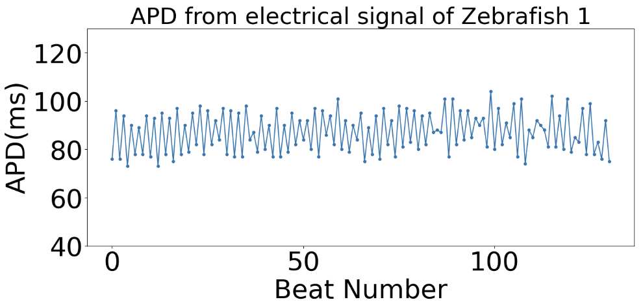
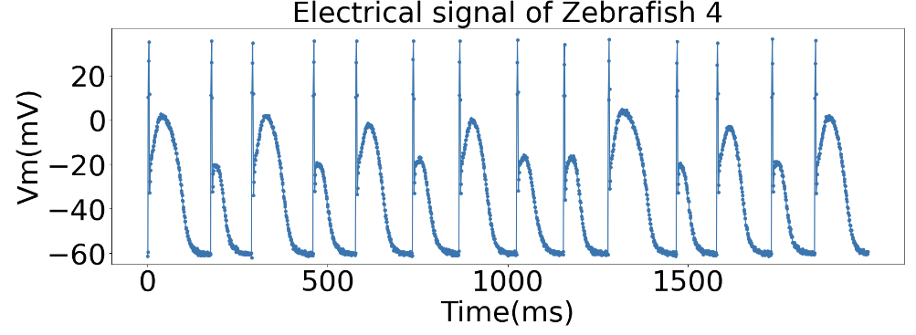
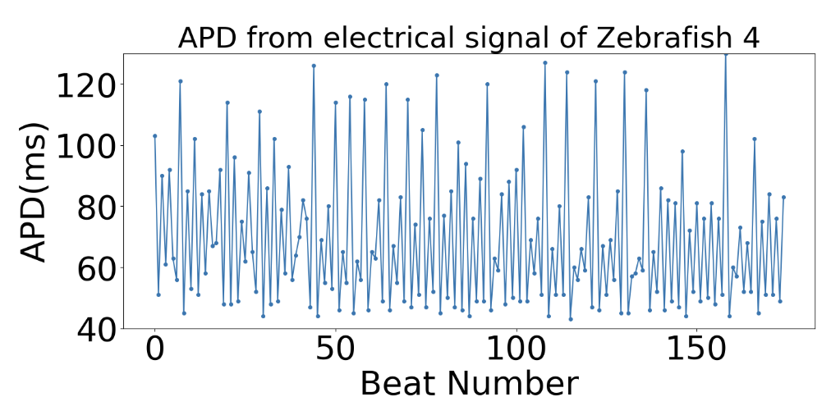
Quantify fibrillation of heart - Challenge
So, the original electrical signal has too many distracting and useless data points.
Here we introduce a chaos quantification method by Actional Potential Duration (APD).

Slide 6
Quantify fibrillation of heart - Method
Now with help of APD, we could do numerical analysis much more easily, since it excludes useless data points in voltage map.
We are going to apply two different APD data analysis methods to calculate Lyapunov exponent:
Temporal Method: Nonlinear Time Series Analysis (TISEAN)
Spatial Method
Solé, R. V., & Bascompte, J. (1995). Measuring chaos from spatial information. Journal of Theoretical Biology, 175(2), 139–147. https://doi.org/10.1006/jtbi.1995.0126
Hegger, R., Kantz, H., & Schreiber, T. (1999). Practical implementation of nonlinear time series methods: The TISEAN package. Chaos (Woodbury, N.Y.), 9(2), 413–435. https://doi.org/10.1063/1.166424

Slide 7
Temporal Method
Now with help of APD, we could do numerical analysis much more easily, since it excludes useless data points.
To do temporal scalar data analysis, we use the software: Nonlinear Time Series Analysis (TISEAN).
Lyp exp: 0.06
Lyp exp: 0.3
TISEAN

Slide 8
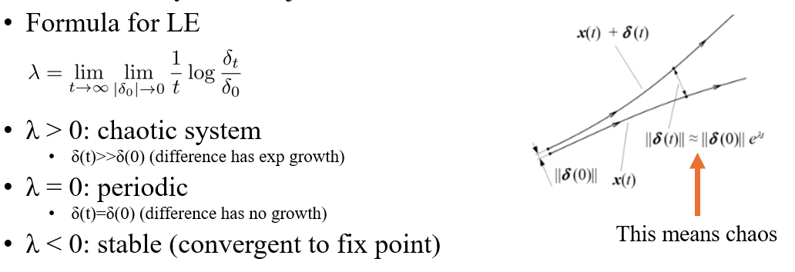
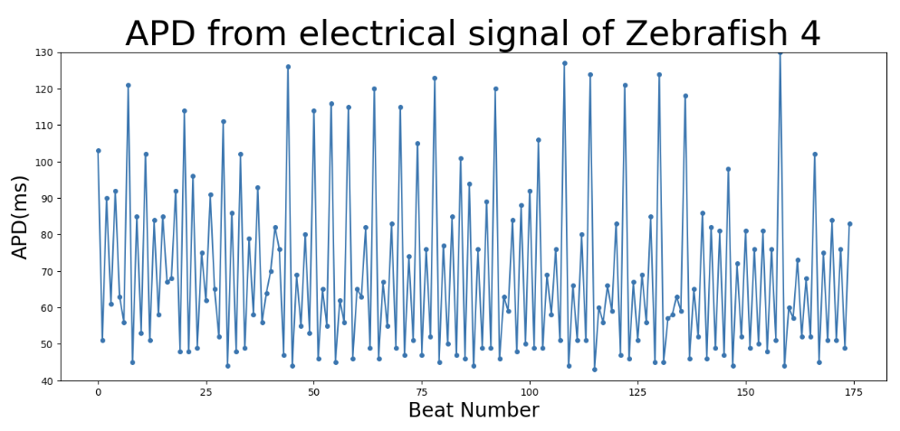
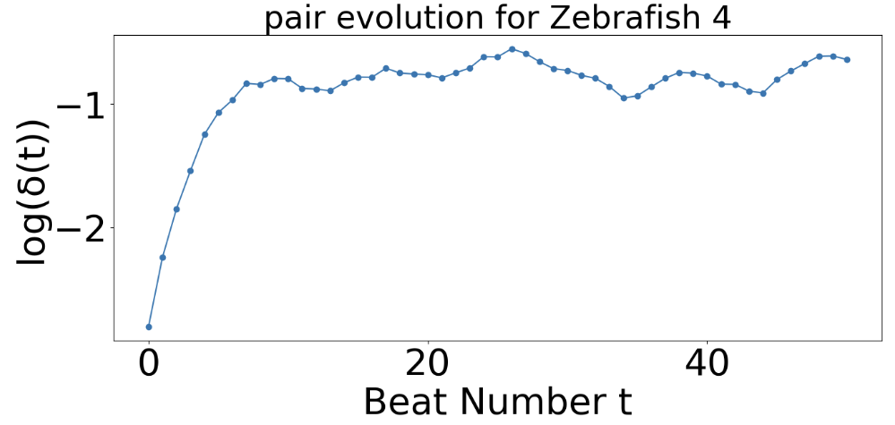
Temporal Method
Basically, TISEAN will do self correlation analysis inside the temporal data series by picking similar data points and see how they diverge from each other.
For example, the two data points in circle are similar, and TISEAN will calculate their evolution after some beat numbers.
Then according to the definition, if any exponential growth, we can find the Lyapunov exponent.
The slope of the robust linear region during evolution will be considered as Lyapunov Exponent.
(or Δn)

Slide 9
Method – Spatial temporal lya exp
A spatiotemporal LE is defined:
s means spatial
k = every point of 2D map from t_i to t_(i+d)
h = neighboring points of k from t_i to t_(i+d) (neighbor distance < a small value)
d = embedded dimension
N_p = number of <k, h> pairs (take average)
j = type of X variable
i = time step
Solé, R. V., & Bascompte, J. (1995). Measuring chaos from spatial information. Journal of Theoretical Biology, 175(2), 139–147. https://doi.org/10.1006/jtbi.1995.0126

Slide 10
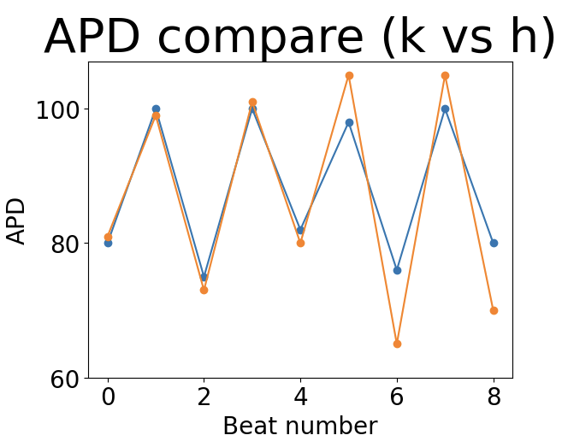
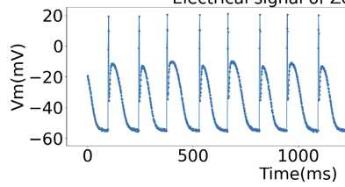
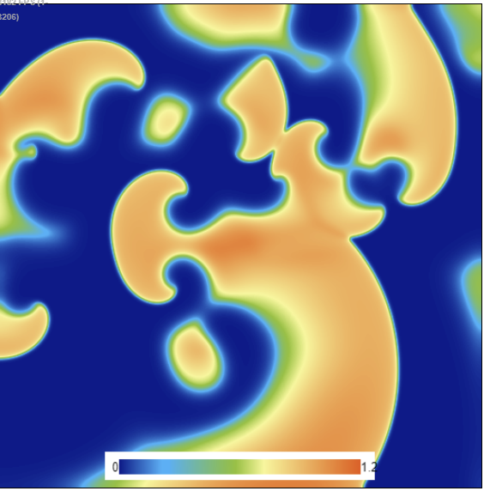
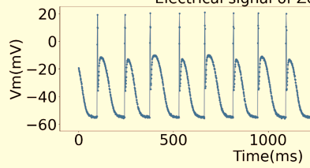
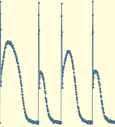
Spatial Method
We first calculate APD sequence for n points (depending on how many we want)
Then we find any points that have similar APD at same Beat Number.
Voltage for k
k
Voltage for h
h

Slide 11
Spatial Method
Then it iterates through all possible spatial pairs in map.
And evolve all the pairs, to see how they diverge.
Finally, after spatially and temporally averaged, we get spatial Lyapunov exponent
k
h’
k’
h

Slide 12
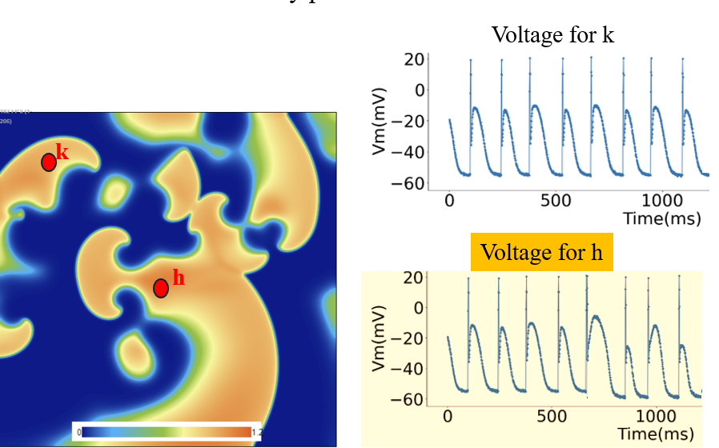
Method – Temporal and Spatial
Both temporal and spatial methods can be used to calculate LE
We can use temporal method when we have temporal information
We can use spatial method when we have both spatial and temporal information.
Let’s see how they work in simulation and experiment.
Simulation: Temporal and Spatial
Experiment 1: Temporal
Experiment 2: Spatial

Slide 13
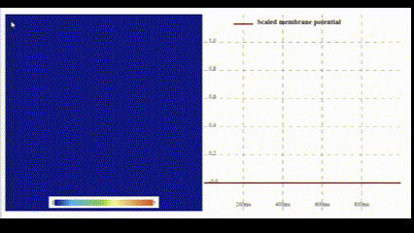
Quantify fibrillation of heart – Simulation
We developed a new method to simulate complicated system in GPU using webGL.
https://abubujs.org/ (Dr. Abouzar Kaboudian)
It can run real-time simulation on PC, tablet and even cell phone.
Take 3V-SIM model as an example.
Wave propagating
(simulation)

Slide 14
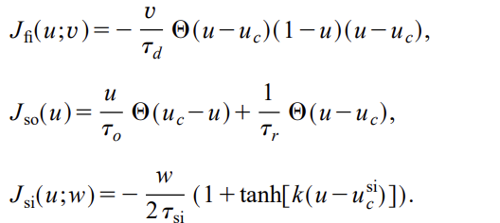
Simulation – 3V SIM model
3V: three variables (u: membrane voltage, v: fast ionic gate and w: slow ionic gate)
It is a model that retains the minimal ionic complexity
Ifi , Isi and Iso correspond to the fast and slow inward, and slow outward (or to be simplified, Na, Ca, and K) currents

Slide 15
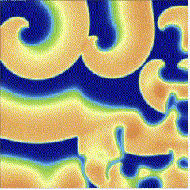
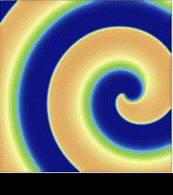
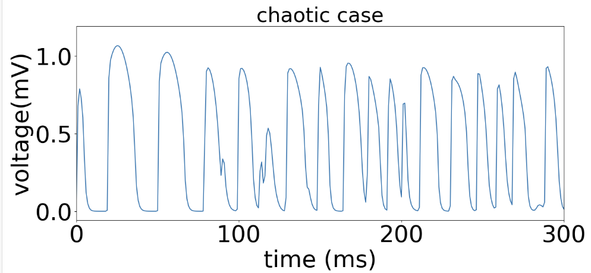
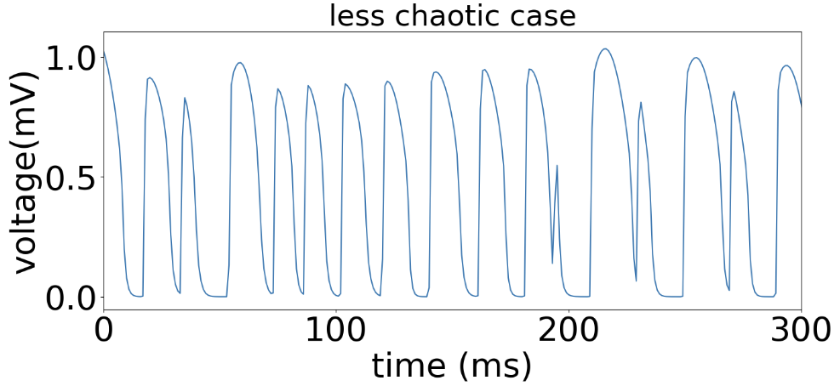
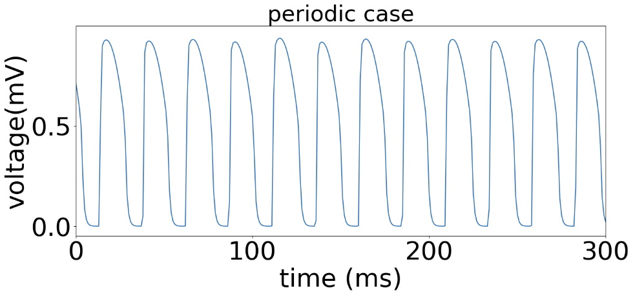
Simulation – 3V SIM model
By proper modification of parameters, we have three simulation with different chaotic degree.
Tau_d = 0.4
Tau_d = 0.41
Tau_d = 0.42

Slide 16
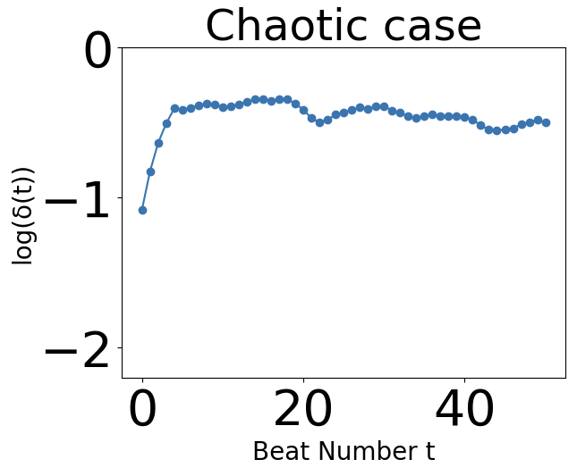
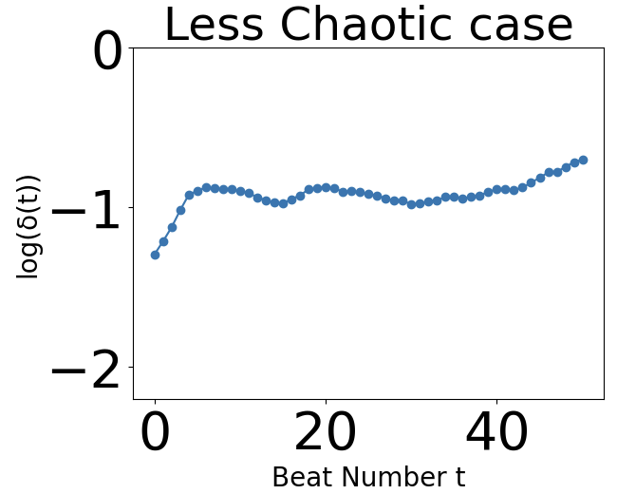
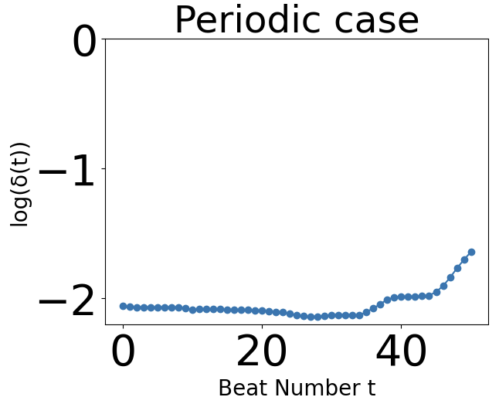
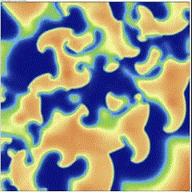
Simulation – 3V SIM model
Temporal LE ~ 0.17
Spatial LE ~ 1
Temporal LE ~ 0.1
Spatial LE ~ 0.5
Temporal LE ~ 0
Spatial LE ~ 0

Slide 17
Quantify fibrillation of heart – Experiment 1
The Zebrafish data is from Microelectronic pins with direct measurement of voltage on the fish heart.
Some Pics here

Slide 18
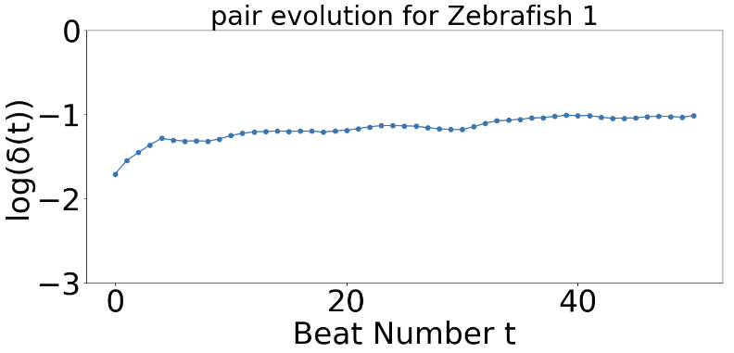
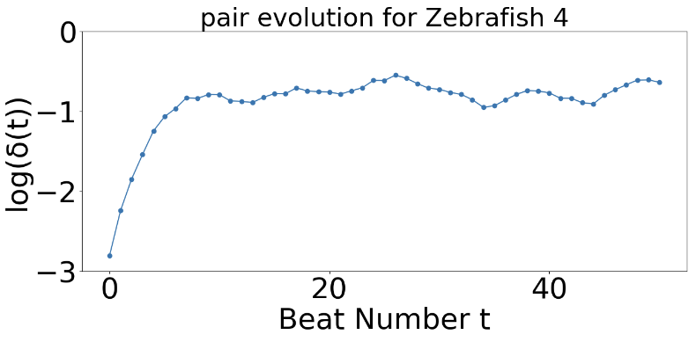
Quantify fibrillation of heart – Temporal Method (Result)
Now, let’s see what we get for Zebrafish heart.
Lyp exp: 0.06
Lyp exp: 0.30

Slide 19
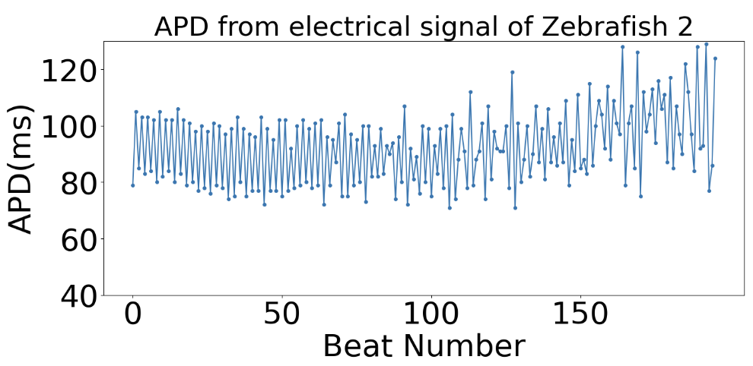
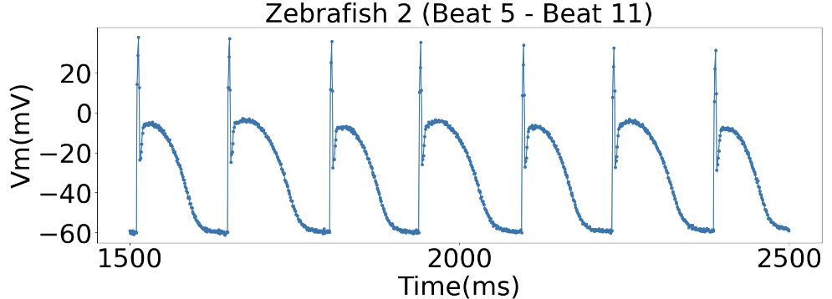
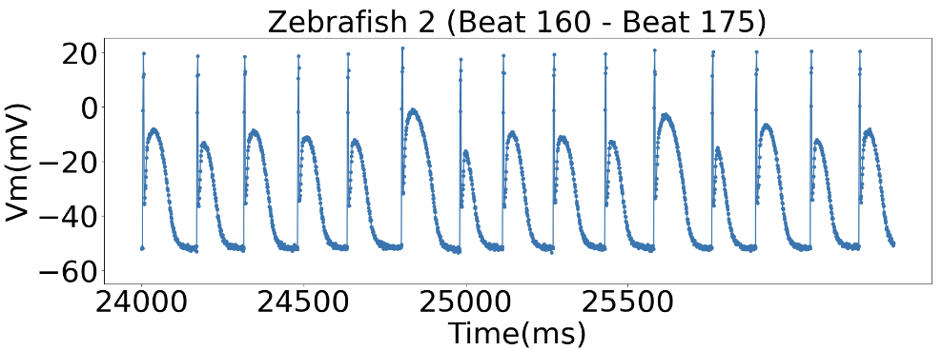
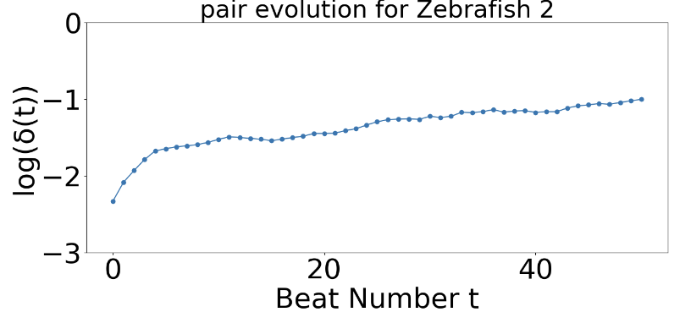
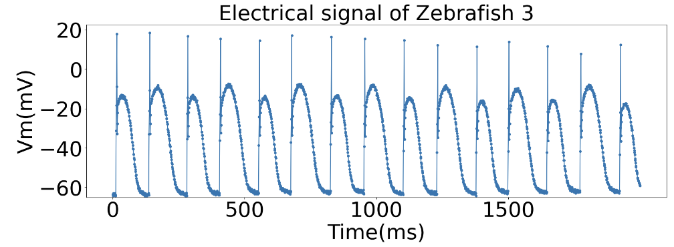
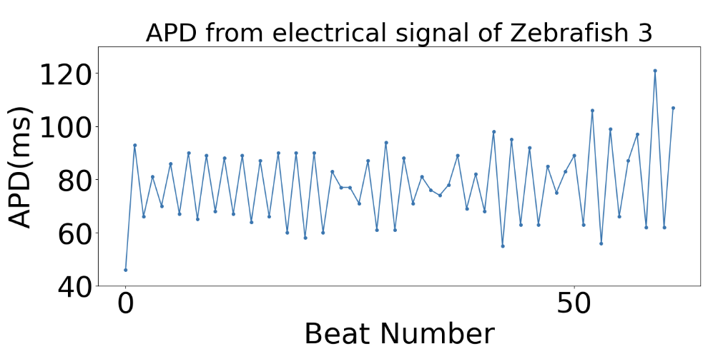
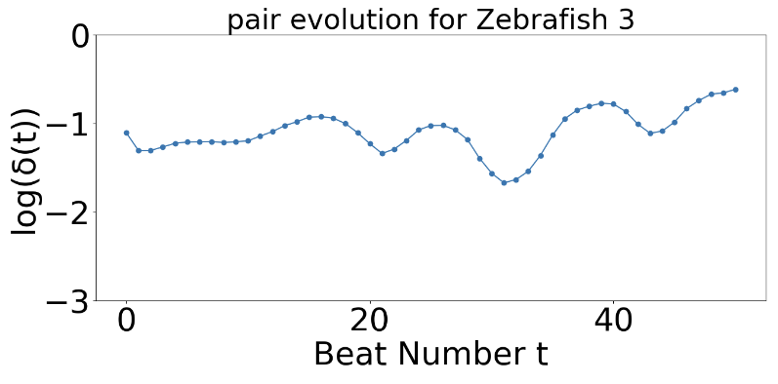
Quantify fibrillation of heart – Temporal Method (Result)
Now, let’s see what we get for Zebrafish heart.
Lyp exp: 0.11
Lyp exp: 0.02

Slide 20
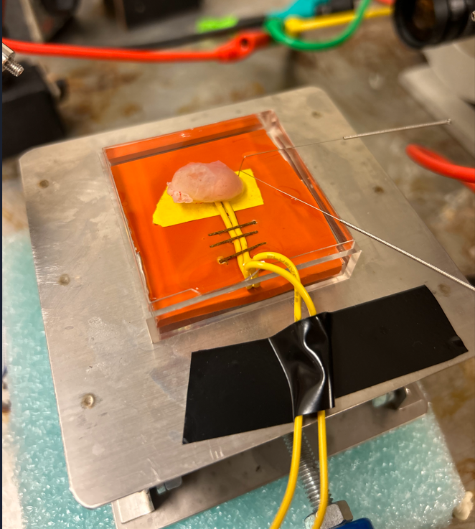
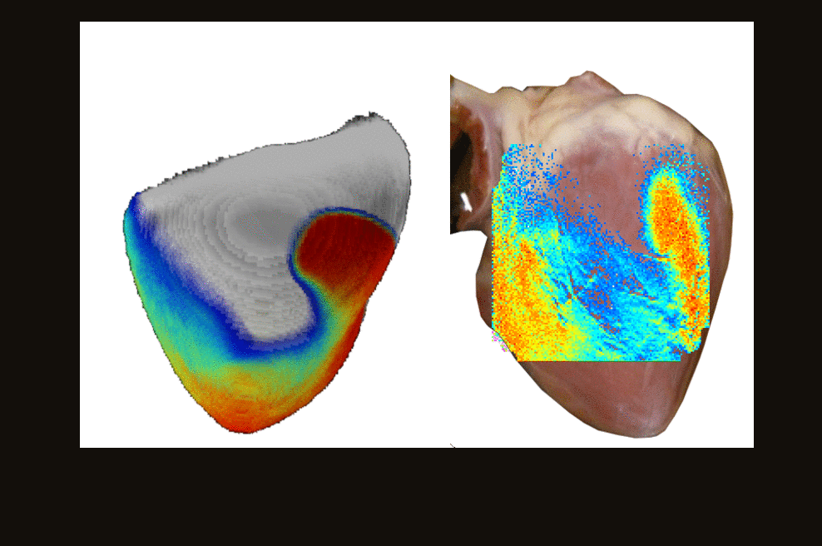
Quantify fibrillation of heart – Experiment 2
Optical Mapping setup

Slide 21
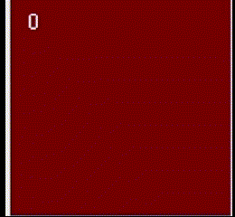
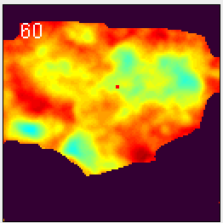
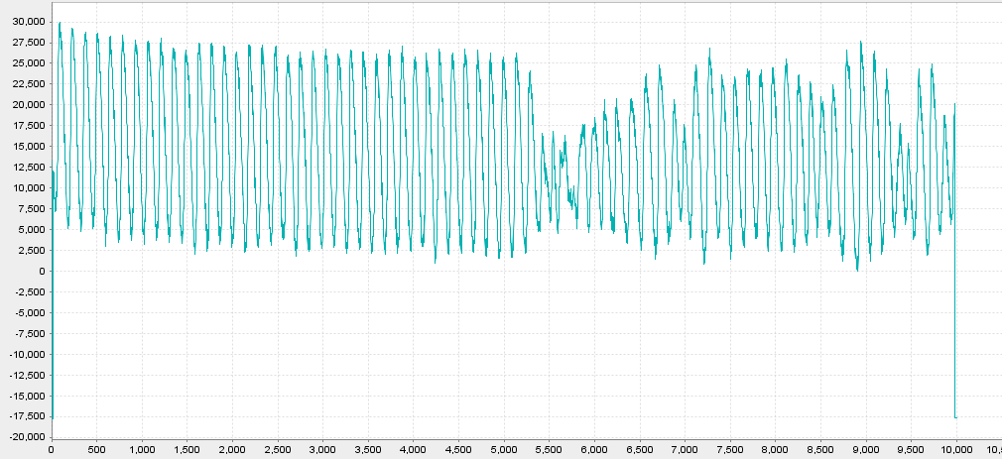
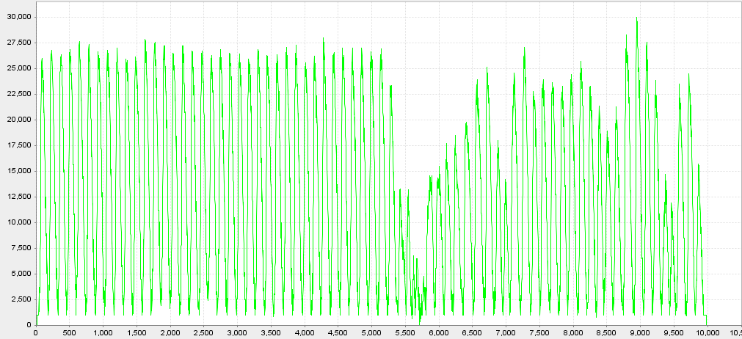
Quantify fibrillation of heart – Spatial Method (Result)
How we handle the data.
We first do noise elimination (temporal and spatial)
Then mask out noise
Then we drift voltage to same bottom
We plot the bottom line as the APD threshold (red line) and obtain APD based on that

Slide 22
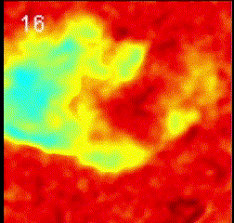
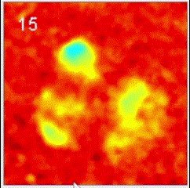
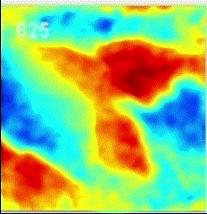
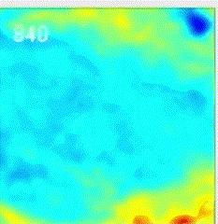
Quantify fibrillation of heart – Spatial Method (Result)
Chaotic fibrillation in pig heart captured by two cameras
Less chaotic fibrillation
Healthy heart (Periodic)
Cam 0
Cam 1

Slide 23
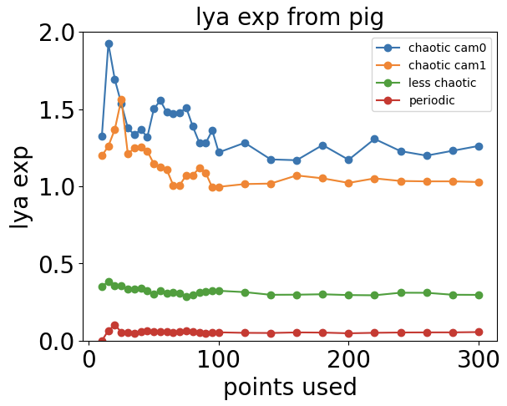
More result from optical mapping (cam 1)
Chaotic, cam 0
Chaotic, cam 1
Periodic
Less chaotic

Slide 24
Conclusions
We have shown that it is possible to quantify the fibrillation of heart by calculating Lyapunov exponent of APD with spatial and temporal methods.
Since the WebGL makes simulation computational cheap, we could do fibrillation analysis quantitively on different parameter sets and related studies on drug effect with even more complicated model (OVVR model)
Besides simulation, the methods mentioned here works well in experiment to distinguish chaotic and non-chaotic patterns.
Future studies on hyperparameters (embedded dimension, neighboring distance) in those methods with their effect on Lyapunov exponent calculation in cardiac system could be done.
We have also shown that different camera in optimal mapping experiment won’t change the spatial Lyapunov exponent of system dramatically, which should be in certain range.

